Slide 1

SAP BTP ABAP on Cloud / RAP Training
DAY-14
Anubhav Oberoy
www.AnubhavTrainings.com
Follow excellence with sheer passion

Slide 2


DISCLAIMER
The training content and delivery of this presentation is confidential, and cannot be recorded, or copied and distributed to any third party, without the written consent of Anubhav Trainings

Slide 3

01
Analytic Use case
02
Develop data model
03
Create ALP
04
Create OVP
Notes:
https://pixabay.com/photos/san-francisco-transamerica-pyramid-1633203/

Slide 4
Steps to implement the approver scenario
Go to base behavior definition and add non factory actions, provide implementation for the same
Create copy from processor cds entity projections and make new cds entities for projection for approver. Both travel and booking, ignore the booking supplement as a approver will only allowed to view upto the booking data.
Create metadata extensions for approver. Since approver can only see the data of travel and booking, we only created 2 MDE. Keep all the relevant fields and integrate code to show accept and reject travel buttons.
Now we provide behavior definition projection for approver which controls what an approver can do. As we know an approver can only edit bookingfee and travel status, he/she not allowed to create/update/delete any of the entities.
Customize our BDEF according to the needs of our user scenario.
Create a service definition for approver and service binding for approver.
Testing ☺
www.anubhavtrainings.com

Slide 5
Steps to implement the approver scenario
Go to base behavior definition and add non factory actions, provide implementation for the same
Create copy from processor cds entity projections and make new cds entities for projection for approver. Both travel and booking, ignore the booking supplement as a approver will only allowed to view upto the booking data.
Create metadata extensions for approver. Since approver can only see the data of travel and booking, we only created 2 MDE. Keep all the relevant fields and integrate code to show accept and reject travel buttons.
Now we provide behavior definition projection for approver which controls what an approver can do. As we know an approver can only edit bookingfee and travel status, he/she not allowed to create/update/delete any of the entities.
Customize our BDEF according to the needs of our user scenario.
Create a service definition for approver and service binding for approver.
Testing ☺
www.anubhavtrainings.com

Slide 6
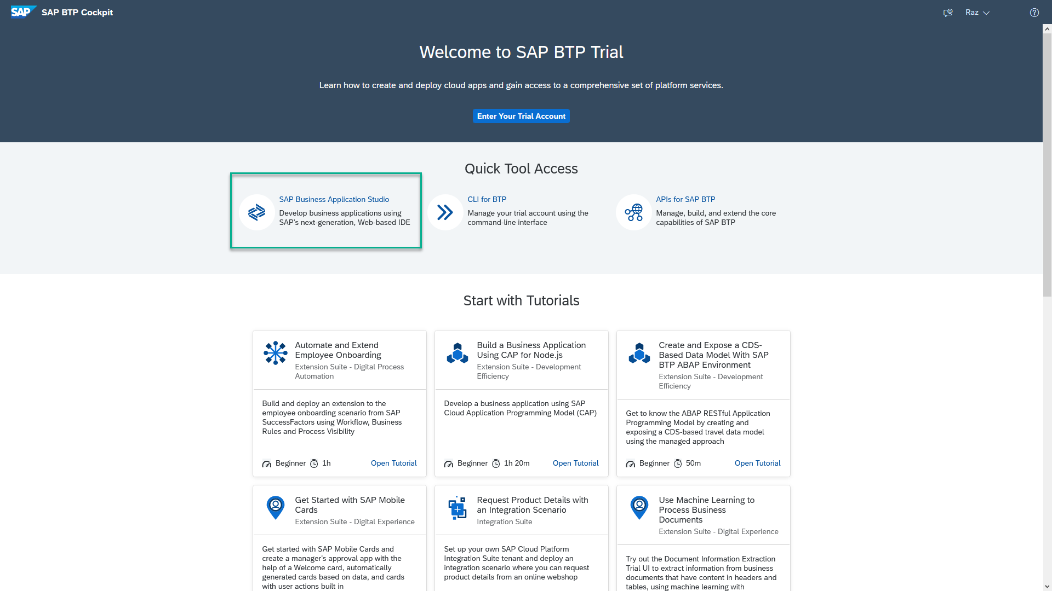
Business Application Studio
SAP Business Application Studio is a development environment available on SAP Business Technology Platform. It is a multi cloud development environment to create different kinds of Apps like HANA Native, CAPM, Fiori, MDK etc. A developer must create private dev space in the system in order to build application in BAS tool, All the required tooling is pre-configured in BAS.
In an Enterprise Account you can set up SAP Business Application Studio as a Free-Tier service by checking its free plan during its entitlement configuration.

Slide 7
Dev Space in BAS
We don’t want a single developer to consume all the available resources
We want a clear isolation of one developer with another
Pre-configured by sap for specific development
Solution - Virtualize
Dev Space
Dev Space
Dev Space
SAP BAS – Business App Studio
SAP BTP – Platform as a Service
IaaS – Infrastructure as a Service

Slide 8
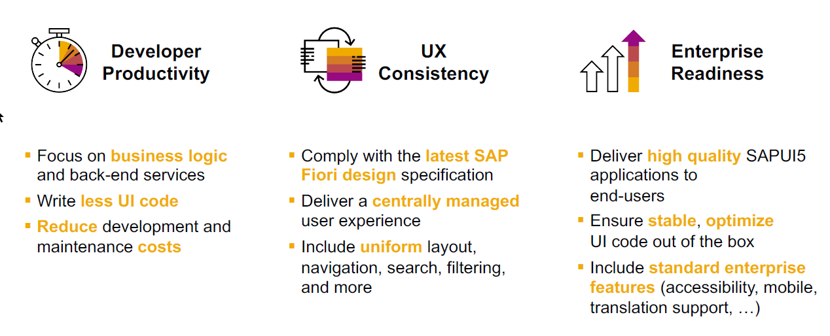
SAP Fiori elements boosts SAP Fiori development efficiency

Slide 9
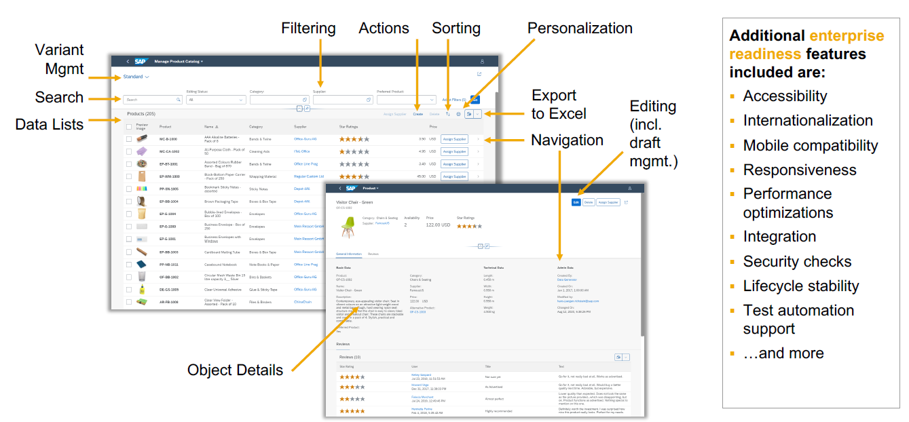
SAP Fiori elements provides enterprise-ready apps out of the box

Slide 10
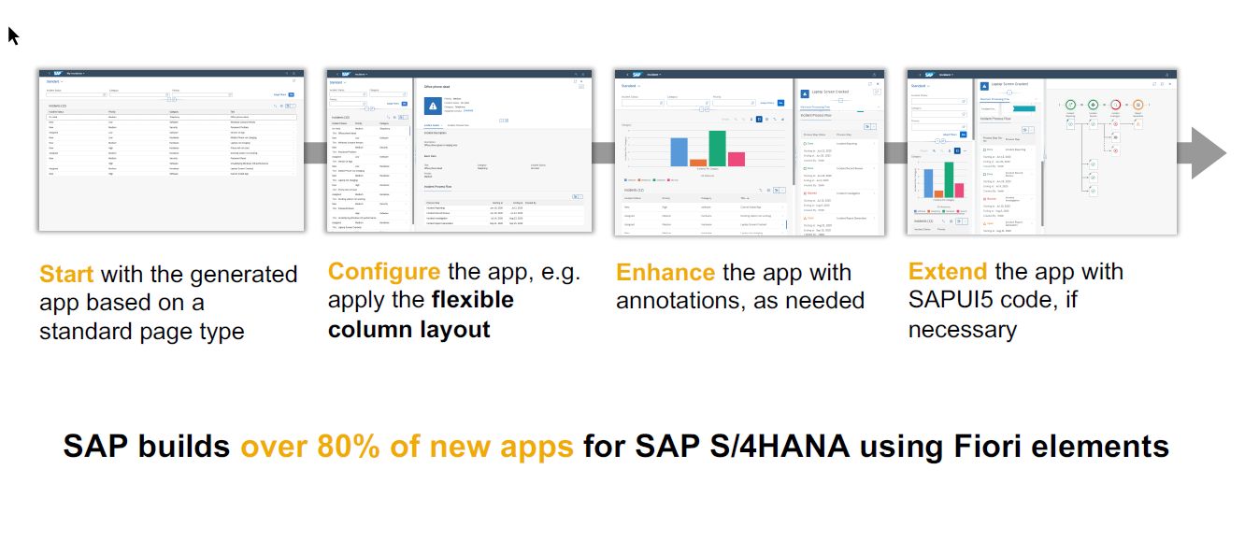
SAP Fiori elements application architecture provides flexibility

Slide 11

SAP Fiori elements prioritizes efficiency over flexibility

Slide 12

















Slide 13
Structure of the Fiori App
Currently you are testing the Fiori App by using the standard preview option in eclipse tool. Will our end user have the ability and skill to open eclipse tool, go to package and search BIMP and then open preview and that too in production system.
All the Fiori apps which we create in BTP will be called MTA – Multi target application, they are deployed with mta.yml file. Which will contain the configuration for the Fiori App.
In SAP BTP, there is a storage space called html-5-repository where the BTP will store our Fiori apps.
When we deploy our app, there is html5-deployer which will take our app from BAS tool and deployes it to the HTML5 Repository (Design time)
When we run the app, there is a service called html5-rt (runtime) service which will load our app from the repository in the build workzone.
Apart from that the application will contain a connectivity service to communicate with our abap on cloud system.
And a destination service which will read the destination (RFC) of AOC system to access data in Fiori.
www.anubhavtrainings.com

Slide 14
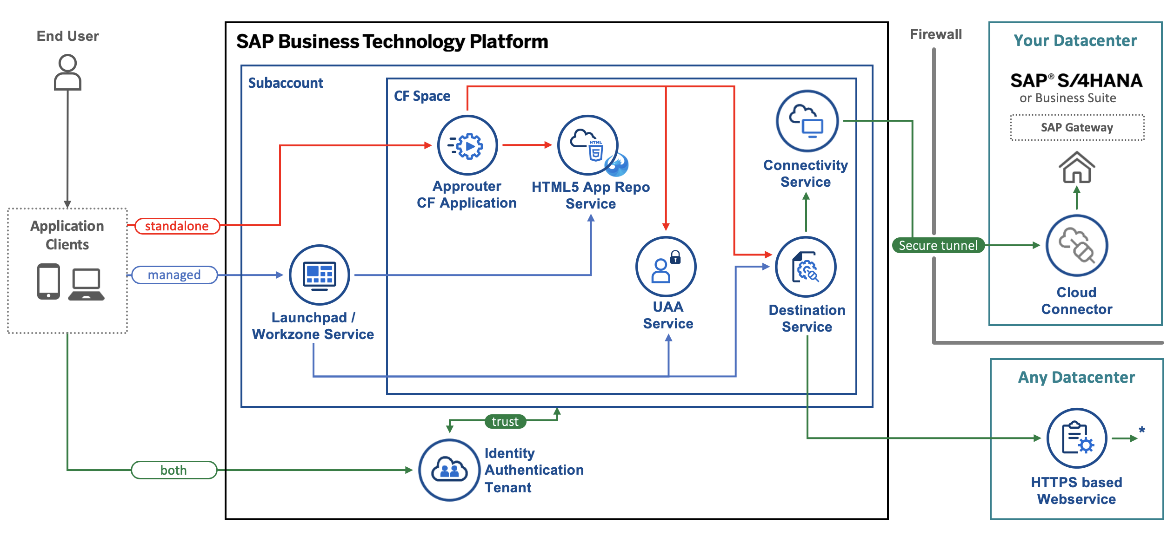
Architecture
www.anubhavtrainings.com
Notes:
https://www.google.com/url?sa=i&url=https%3A%2F%2Fcommunity.sap.com%2Ft5%2Ftechnology-blogs-by-sap%2Fbuild-and-deploy-ui5-freestyle-applications-to-sap-btp-cloud-foundry%2Fba-p%2F13558501&psig=AOvVaw3K_6niI7dmyPfs2VgcYMQf&ust=1726066695091000&source=images&cd=vfe&opi=89978449&ved=0CBcQjhxqFwoTCOicgdPRuIgDFQAAAAAdAAAAABAg

Slide 15
Tools and Services to Deliver the App
Business Application Studio – It is a multi cloud development tool which allows developers to build, test, package, deploy, and manage end to end Fiori applications.
SAP build work zone (aka cFLP in BTP) – it helps us to configure a site called Fiori launchpad in the cloud. All the Fiori Apps which you build in BTP will be accessed via this build workzone from end user. End user will get single URL, which contains the tiles for all our apps deployed in BTP.
Continuous Integration Service – When a developer change the application, and push to central repository like git, the CI service will automatically build and deploy our app.
www.anubhavtrainings.com

Slide 16
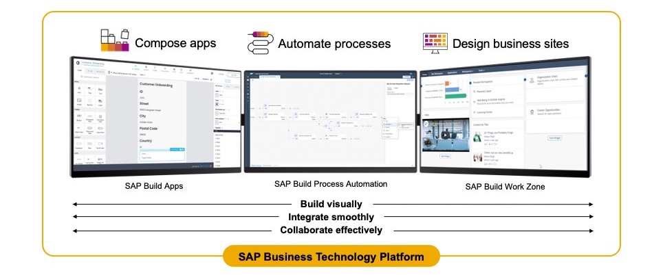
SAP Build – An introduction
www.anubhavtrainings.com

Slide 17
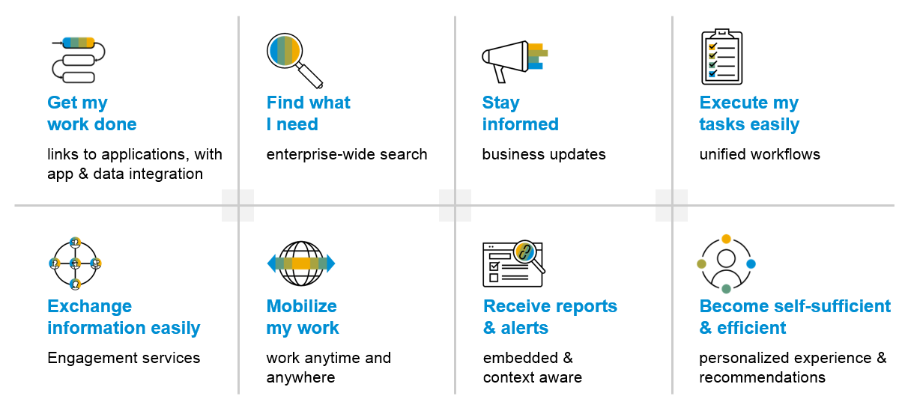
SAP Build Work zone – Key benefits
www.anubhavtrainings.com

Slide 18
Additional configuration before deployment
{
"xsappname": "comatstproctravelprocessorapp",
"tenant-mode": "dedicated",
"description": "Security profile of called application",
"scopes": [],
"role-templates": [],
"oauth2-configuration": {
"token-validity": 60000,
"refresh-token-validity": 2592000,
"redirect-uris": [
"https://*.cfapps.us10-001.hana.ondemand.com/login/callback"
]
}
}
www.anubhavtrainings.com

Slide 19




























Slide 20











Slide 21
How did Anubhav build and deploy fiori
Create the Dev space in BAS tool
Open the bas tool and open folder to choose projects folder
We have to open terminal and login to btp a/c cf login -a https://api.cf.us10-001.hana.ondemand.com --sso
Press F1 and choose open application generator to generate Fiori app of template: List Report Template
Select the system as AOC and choose our service binding name for processor
Provide app details, deployment details (btp), launchpad details and create app
Right click on mta.yml and build MTA archieve
Choose F1, open application info and select deploy
Assign the roles of our Launchpad service to our user
Open SAP Build workzone and create a site with name mylaunchpad
Go to channel manager and refresh the apps which are stored in html5-repository
Go to content manager and choose content explorer and pull the app
Create a catalog and a group and add our app to them
Go to everyone role and assign the app to the role
Open the site to test our app
Repeat the same steps if there is a change in the app.
We need to create a git repository and push our app code (backup)
Register a web hook and use the same in CI CD service so that the application will deploy automatically to BTP cloud
www.anubhavtrainings.com

Slide 22
Git and ABAP on git
Git is a source code repository management system, git hub is a repository on internet. We interact with github using git software. If I want to take a backup of all our code which we created in AOC system, git is a great choice. This way we can also export import our code between cloud and on-premise system.
For cloud system, we use git plugin in eclipse which is provided by SAP. The installation was covered in 3rd session.
Steps:
We need to add the plugin for abap git in ADT - http://eclipse.abapgit.org/updatesite/
Create a github account and add a PAT token under developer setting
Create a repository in git hub
Click on Add to link a repository and paste url from step 3
www.anubhavtrainings.com

Slide 23
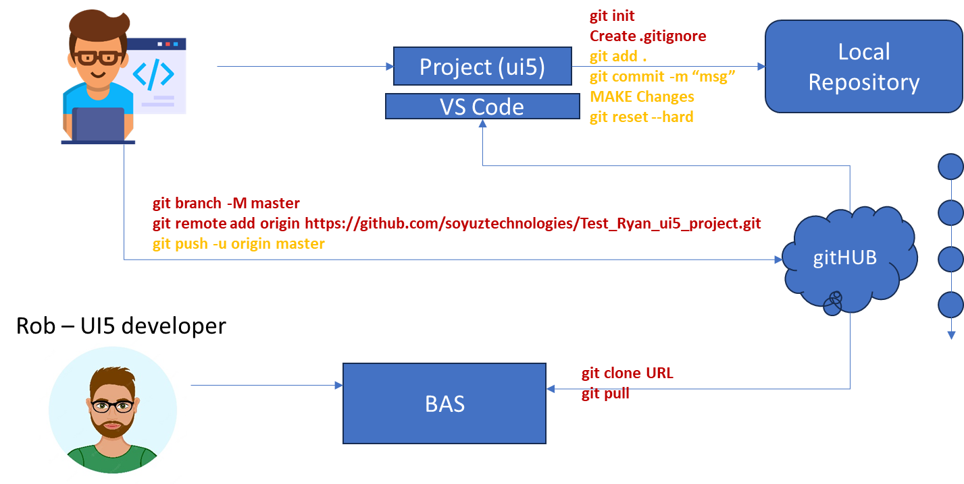
Git and Git HUB

Slide 24
Architecture
www.anubhavtrainings.com
Notes:
https://www.google.com/url?sa=i&url=https%3A%2F%2Fcommunity.sap.com%2Ft5%2Ftechnology-blogs-by-sap%2Fbuild-and-deploy-ui5-freestyle-applications-to-sap-btp-cloud-foundry%2Fba-p%2F13558501&psig=AOvVaw3K_6niI7dmyPfs2VgcYMQf&ust=1726066695091000&source=images&cd=vfe&opi=89978449&ved=0CBcQjhxqFwoTCOicgdPRuIgDFQAAAAAdAAAAABAg

Slide 25
Git and ABAP on git
Git is a source code repository management system, git hub is a repository on internet. We interact with github using git software. If I want to take a backup of all our code which we created in AOC system, git is a great choice. This way we can also export import our code between cloud and on-premise system.
For cloud system, we use git plugin in eclipse which is provided by SAP. The installation was covered in 3rd session.
Steps:
We need to add the plugin for abap git in ADT - http://eclipse.abapgit.org/updatesite/
Create a github account and add a PAT token under developer setting
Create a repository in git hub
Click on Add to link a repository and paste url from step 3
www.anubhavtrainings.com

Slide 26




Git and Git HUB

Slide 27
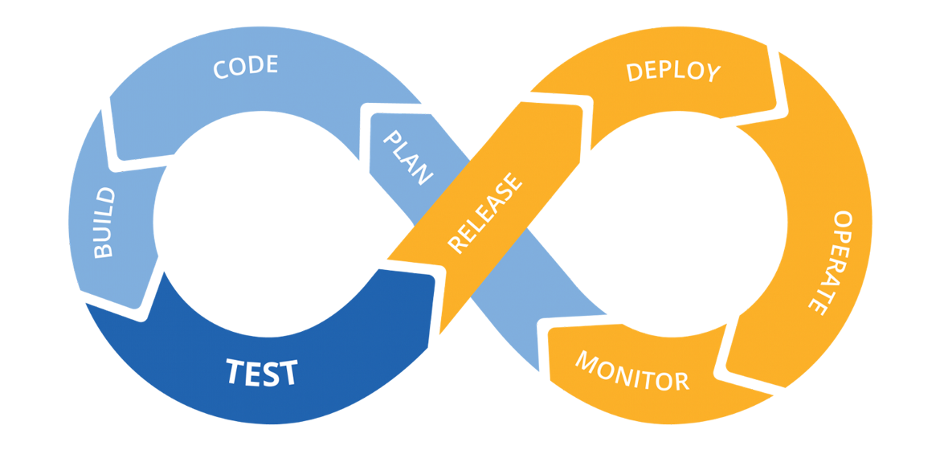
Hands on: Continuous Integration

Slide 28
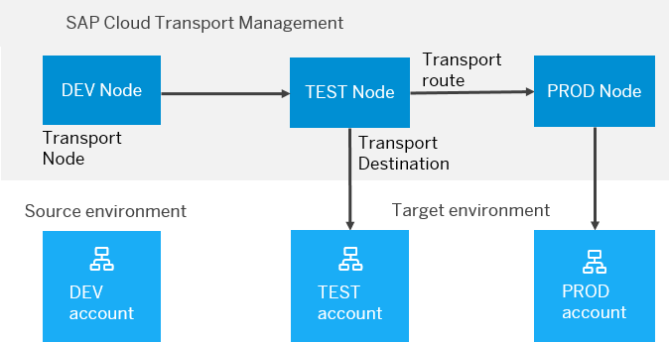
BTP Cloud Transport Management
SAP Cloud Transport Management service lets you manage software deliverables between accounts of different environments (such as Neo and Cloud Foundry), by transporting them across various runtimes. This includes application artifacts as well as their respective application-specific content.
SAP Cloud Transport Management service adds transparency to the audit trail of changes so that you get information about who performed which changes in your production environment, and when they did it. At the same time, the service enables a separation of concerns: For example, a developer of an application or of SAP Cloud content artifacts can trigger the transport of changes in a development subaccount, while the resulting import into the test, and production subaccount is handled by a central operations team.

Slide 29
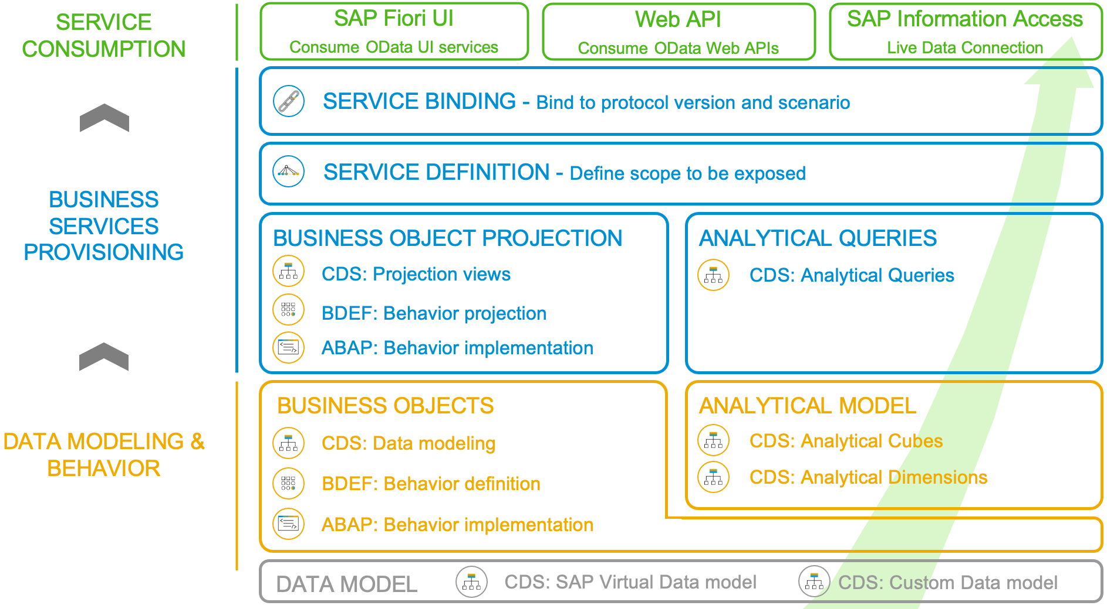
Development Flow of Scenario
With the 2102 release, the SAP BTP ABAP Environment opened up the door for analytics developments. The programming model follows the same “RAP” paradigm as in the transactional world: The entity model is implemented with CDS views that make use of additional analytical annotations that were now also released for the usage in the BTP ABAP Environment ("Steampunk”). As there is no access to the analytical backend transactions nor to the analytical key user tools, an analytical preview was also introduced, so that a developer can test his developments directly in the ABAP Development Tools. Another novelty is the introduction of an analytical service exposure. For an analytical service to be used as real time connection with a supported client (like e.g., SAP Analytics Cloud), the SAP Information Access protocol (InA) is required whereas transactional services rely on the OData protocol.
www.anubhavtrainings.com

Slide 30
ALP Analytic List Page
An Analytical List Page (ALP) is a SAP Fiori element that allows users to analyze data and take action on it. It's a key component of SAP Fiori embedded analytics.
Here are some things you can do with an ALP:
Analyze data: Use KPIs, charts, tables, and visual filters to analyze data from different perspectives
Investigate root causes: Drill down to find root causes
Act on transactional content: Take action on transactional content
Build apps: Create apps that visualize and report data
Combine data: Combine transactional and analytical data using charts and tables
ALPs have a flexible layout that can be customized in a number of ways, including:
Sorting: Sort the work list
Page layout: Set page layout preferences
Filters: Set filters and save filter selections
Default views: Set default views
ALPs are organized into two sections: a header section for setting filters, and a content section for displaying charts and lists.
www.anubhavtrainings.com

Slide 31
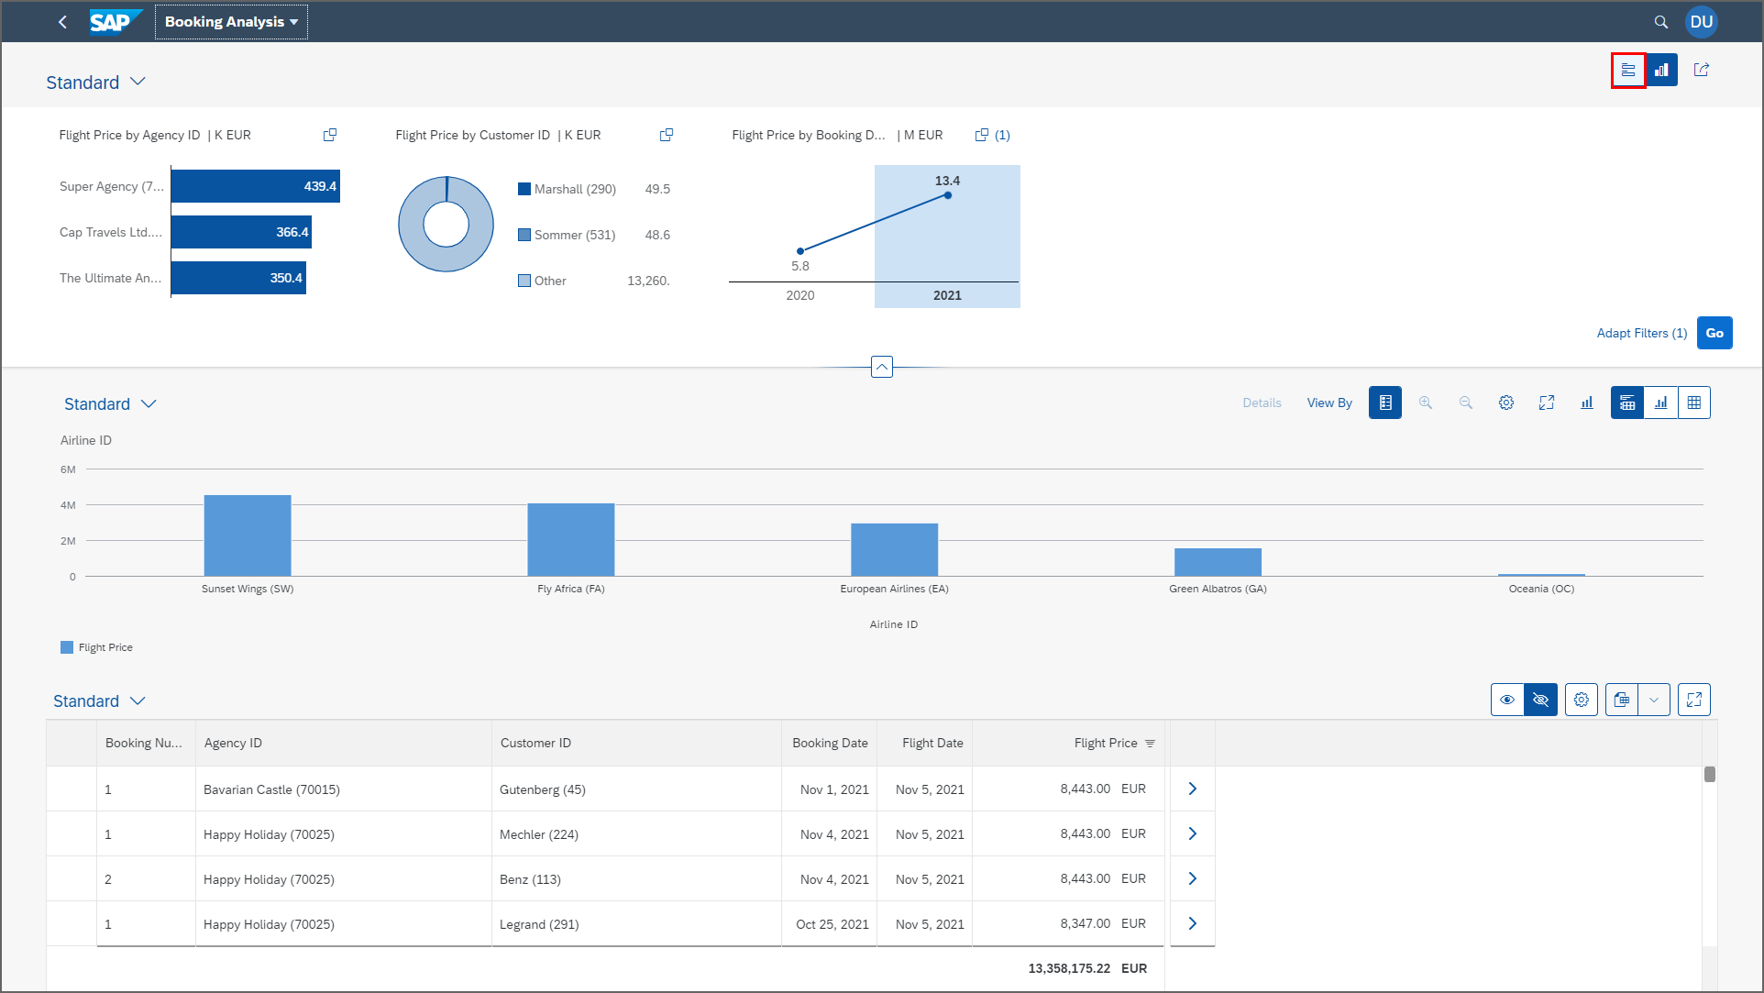
ALP
www.anubhavtrainings.com

Slide 32
Booking Consumption Analytics View
Booking Analytics CDS entity
Travel Analytics CDS entity
Carrier
Connection
/dmo/travel
/dmo/customer
/dmo/agency
Bookings

Slide 33
OVP – Overview pages
The Overview Page (OVP) in SAP is a data-driven app that provides users with a single page of information based on their role or domain. It helps users focus on important tasks by allowing them to quickly view, filter, and react to information.
Here are some things to know about the OVP:
Structure
The OVP has a header area and a content area. The content area displays cards that can contain charts, lists, tables, or text.
Cards
The OVP supports both standard and custom cards. Standard cards are entry-level views of the most relevant app data for a given topic or issue. Custom cards allow you to define the appearance and content of a card.
List cards
The OVP supports three types of list cards: list card, bar chart list card, and link list card.
Flavors
List cards can have two types of flavors: standard and bar. Standard flavor cards display items as numbers and text, while bar flavor cards display items as a combination of numbers, text, and a bar.
www.anubhavtrainings.com

Slide 34
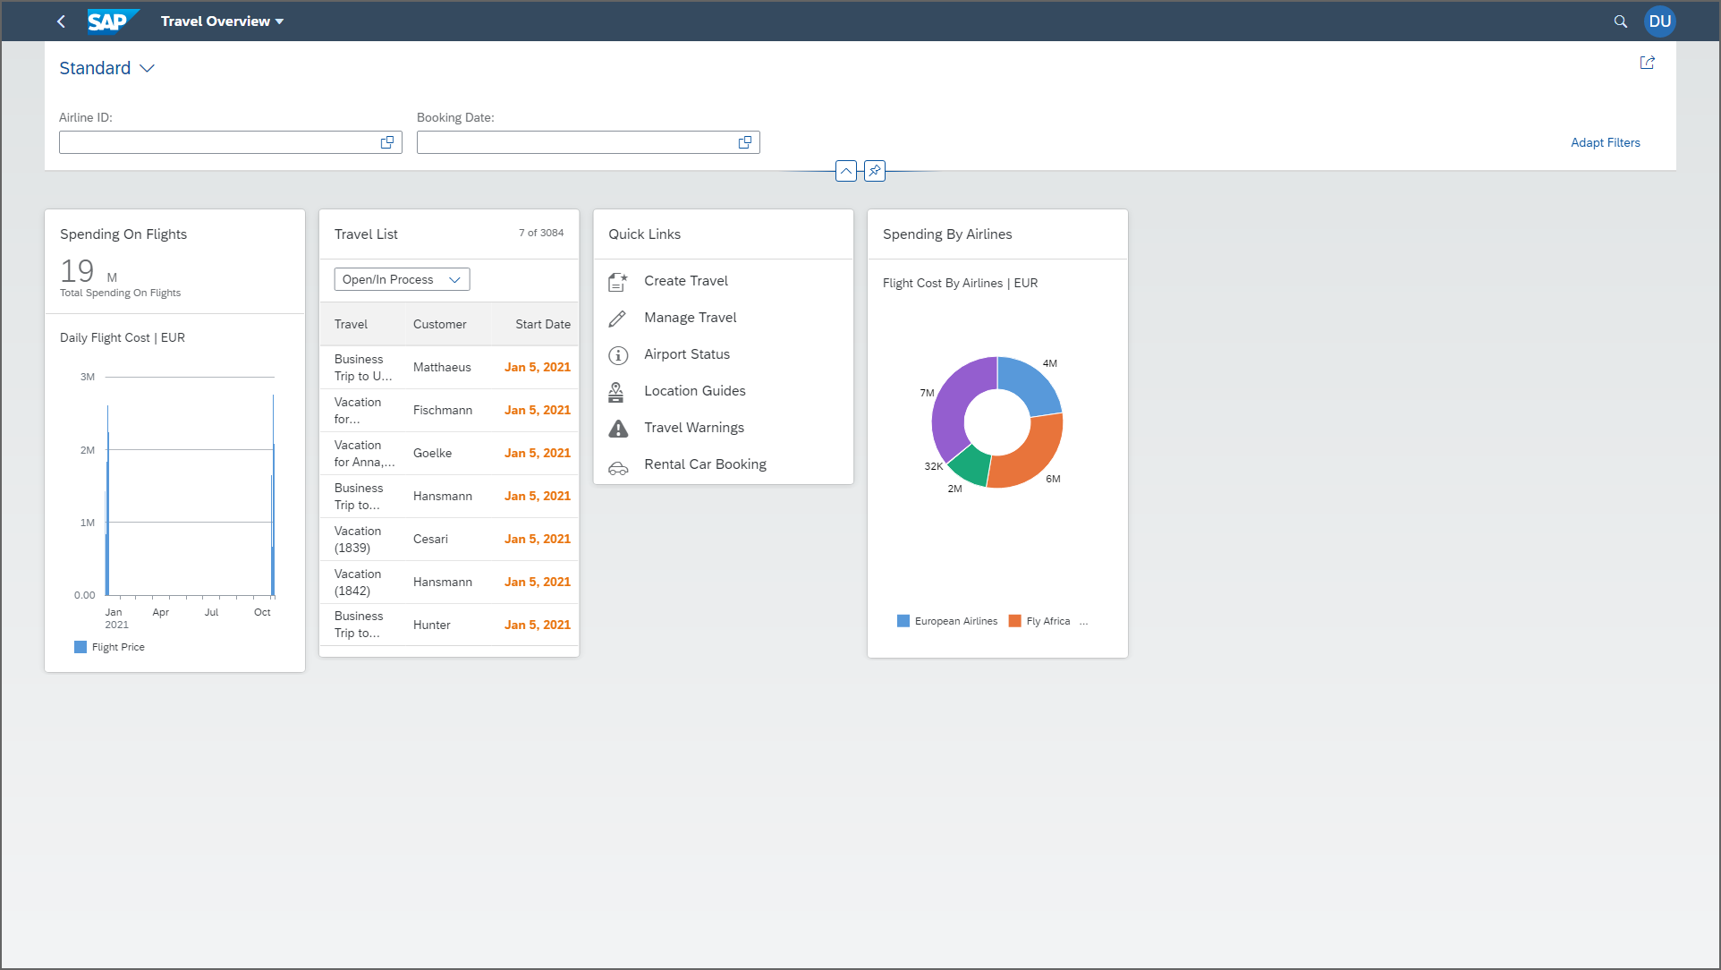
OVP
www.anubhavtrainings.com

Slide 35
www.anubhavtrainings.com
Thank You
End of Day 14
www.anubhavtrainings.com

Slide 36


We’re committed to empower you to be
#FutureReady
through powerful training solutions.
We build the workforce of the future.
250+
Corporate Clients
30,000+
Learners Trained
25000+
Learners Placed
FREE WEBINARS
Sign up for free webinars with industry experts every fortnight!
Enroll Now!
Contact us today!
https://anubhavtrainings.com

